Slide 1
Smart Sorting: Transfer Learning For Identifying Rotten Fruits And Vegetables
SlideMake.com

Slide 2

Introduction to Smart Sorting
Smart sorting involves using advanced technology to classify and organize produce efficiently.
Accurate identification of rotten fruits and vegetables is essential for reducing food waste and ensuring consumer safety.
Transfer learning offers a promising approach to enhance classification accuracy with limited labeled data.
Notes:
Image source: https://opengraph.githubassets.com

Slide 3
Importance of Sorting in Food Industry
Proper sorting improves the quality and shelf life of fresh produce.
Automated systems can significantly reduce labor costs and processing times.
Accurate sorting minimizes the risk of distributing spoiled products to consumers.
Notes:
Image source: https://opengraph.githubassets.com

Slide 4
Challenges in Identifying Rotten Produce
Visual similarities between fresh and slightly rotten produce can cause misclassification.
Variability in lighting and imaging conditions affects detection accuracy.
Limited labeled datasets of rotten produce make training robust models difficult.
Notes:
Image source: https://opengraph.githubassets.com

Slide 5
Overview of Transfer Learning
Transfer learning involves using pre-trained models on new but related tasks.
It reduces the need for large labeled datasets by leveraging existing knowledge.
Commonly used models include CNN architectures like ResNet, VGG, and EfficientNet.
Notes:
Image source: https://opengraph.githubassets.com

Slide 6
Benefits of Transfer Learning in Smart Sorting
Significantly decreases training time and computational resources.
Improves model performance with limited training data.
Facilitates rapid deployment of sorting systems across different types of produce.
Notes:
Image source: https://opengraph.githubassets.com

Slide 7
Data Collection for Rotten Produce Detection
Images are captured under controlled lighting conditions to ensure consistency.
Diverse datasets include various fruits and vegetables at different stages of rot.
Data augmentation techniques are employed to enhance dataset variability.
Notes:
Image source: https://opengraph.githubassets.com

Slide 8
Model Selection and Architecture
Convolutional Neural Networks (CNNs) are suitable for image classification tasks.
Pre-trained models like ResNet50 or EfficientNet are often preferred.
Model complexity is balanced to prevent overfitting and ensure real-time processing.
Notes:
Image source: https://opengraph.githubassets.com

Slide 9
Transfer Learning Workflow
The pre-trained model's feature extraction layers are frozen initially.
The final classification layers are fine-tuned using the collected dataset.
The model is validated and tested on separate datasets to evaluate performance.
Notes:
Image source: https://opengraph.githubassets.com

Slide 10
Training Strategies and Techniques
Data augmentation (rotation, flipping, brightness adjustment) enhances robustness.
Early stopping and learning rate schedules prevent overfitting.
Cross-validation ensures the model’s generalization across different data subsets.
Notes:
Image source: https://opengraph.githubassets.com

Slide 11
Evaluation Metrics
Accuracy measures the overall correctness of the model.
Precision and recall assess the model's ability to identify rotten produce accurately.
F1-score balances precision and recall, especially in imbalanced datasets.
Notes:
Image source: https://www.mdpi.com

Slide 12
Results and Performance
Transfer learning models achieve high accuracy (>90%) in identifying rotten items.
The models demonstrate strong generalization across different produce types.
Real-time classification speeds meet industrial sorting system requirements.
Notes:
Image source: https://opengraph.githubassets.com

Slide 13
Implementation in Sorting Systems
Integration with conveyor belts enables automated sorting based on model predictions.
Systems can be calibrated to separate rotten from fresh produce accurately.
Feedback mechanisms improve system performance over time through continuous learning.
Notes:
Image source: https://opengraph.githubassets.com

Slide 14
Challenges and Limitations
Variability in produce appearance can still cause misclassification.
Model robustness needs to be tested under different environmental conditions.
Large-scale deployment requires addressing hardware and scalability issues.
Notes:
Image source: https://opengraph.githubassets.com

Slide 15
Future Directions in Smart Sorting
Incorporating multispectral and hyperspectral imaging for better detection.
Developing adaptive learning systems that improve over time with new data.
Exploring edge computing for on-site, real-time processing without cloud dependency.
Notes:
Image source: https://opengraph.githubassets.com

Slide 16
Ethical and Sustainability Considerations
Reducing food waste aligns with global sustainability goals.
Ensuring data privacy and security in automated sorting systems is critical.
Transparent algorithms help build trust with consumers and stakeholders.
Notes:
Image source: https://opengraph.githubassets.com

Slide 17
Case Studies and Industry Applications
Several companies have successfully implemented transfer learning-based sorting.
Case studies show improvements in efficiency and product quality.
Collaboration between researchers and industry accelerates technological adoption.
Notes:
Image source: https://opengraph.githubassets.com

Slide 18
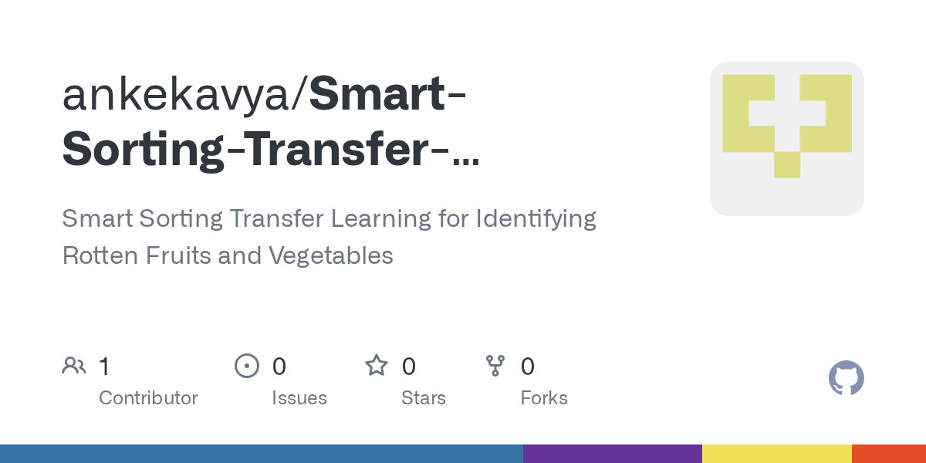
Summary of Key Benefits
Transfer learning enhances classification accuracy with less data.
Automated smart sorting reduces operational costs and waste.
Continuous advancements will further improve detection capabilities.
Notes:
Image source: https://opengraph.githubassets.com

Slide 19
Conclusion
Transfer learning is a powerful tool for identifying rotten produce effectively.
Integrating AI with existing sorting infrastructure offers substantial benefits.
Ongoing research and development will continue to refine these technologies.
Notes:
Image source: https://opengraph.githubassets.com

Slide 20
References
[Include relevant academic papers, industry reports, and sources on transfer learning, image classification, and smart sorting systems.]
Your second bullet
Your third bullet
Notes:
Image source: https://opengraph.githubassets.com

Slide 21
Questions and Discussion
Thank you for your attention.
Feel free to ask questions or share insights about smart sorting technologies.
Let's explore the future of automated produce quality assessment together.
Notes:
Image source: https://opengraph.githubassets.com

